Slide 1


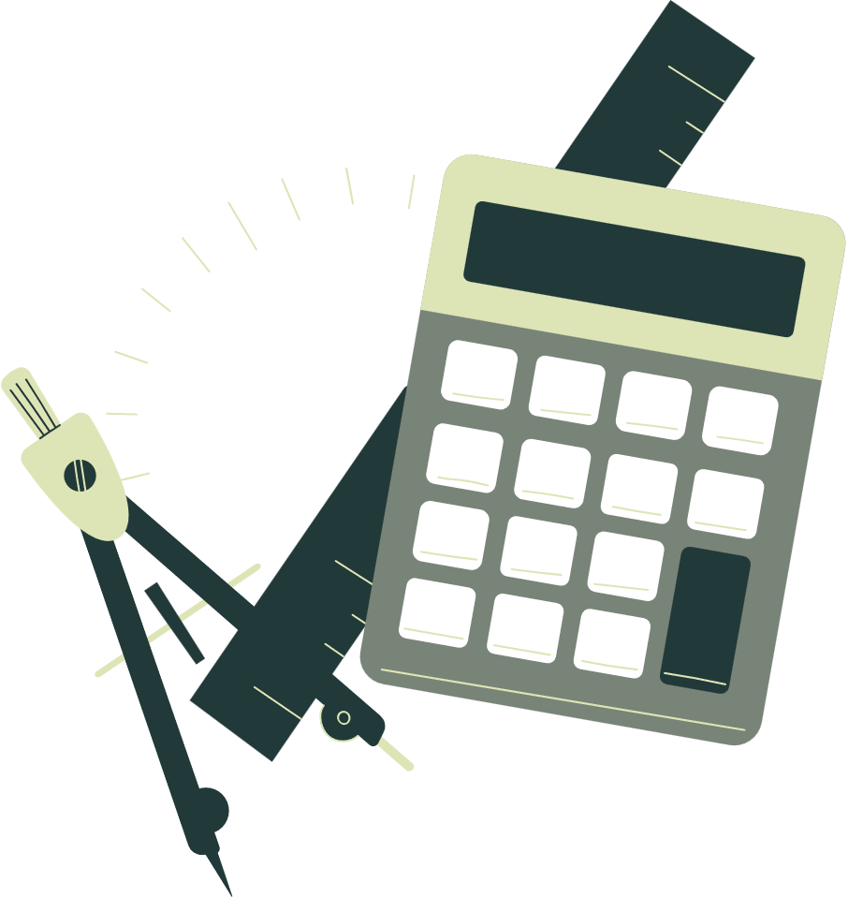


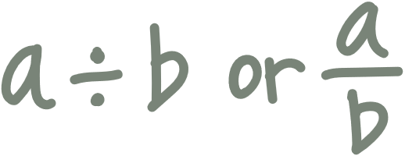
Welcome to our
MATHEMATICS
Class
Prepared by: Mr. Fajardo

Slide 2
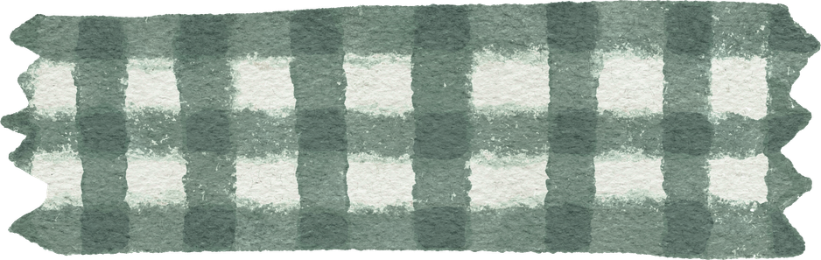
Learning Objectives
Find the square root of perfect square numbers
Solve quadratic equations by extracting square roots

Slide 3
Math Investigation

Slide 4
Math Investigation
A community is building a square garden where children can enjoy nature and learn about plants. The garden must have an area of 64 square meters. Before construction begins, the volunteers need to determine the length of each side of the square.

Slide 5
Let’s recall!

Slide 6
Let’s recall!
Simplify the expression by finding its square root.

Slide 7

Simplify the expression by finding its square root.
$$\sqrt{25}$$

Slide 8

Simplify the expression by finding its square root.
$$\sqrt{49}$$

Slide 9

Simplify the expression by finding its square root.
$$\sqrt{121}$$

Slide 10

Simplify the expression by finding its square root.
$$\sqrt{169}$$

Slide 11
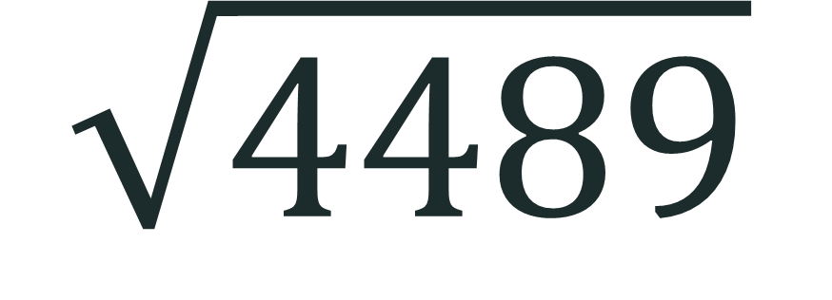
Simplify the expression by finding its square root.
$$\sqrt{4489}$$

Slide 12
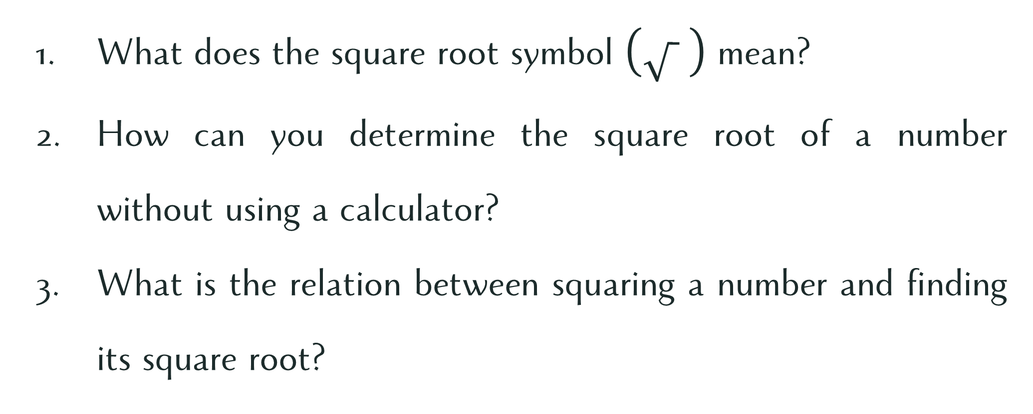
Processing Questions:
What does the square root symbol mean?
How can you determine the square root of a number without using a calculator?
What is the relation between squaring a number and finding its square root?

Slide 13
Quadratic equations
Solving
by Extracting Square Roots

Slide 14



Solve the Quadratic Equations by Extracting Square Roots.
$x^{2}=49$
$x^{2}=36$
$x^{2}−81=0$
$2x^{2}=200$
$2{\left(x−1\right)}^{2}=8$

Slide 15
Let’s practice!

Slide 16

Let’s Practice!
Solve the quadratic equations by extracting the square roots.
$x^{2}−196=0$
$3x^{2}−27=0$
$3{\left(x−2\right)}^{2}=75$

Slide 17
Seatwork 1

Slide 18
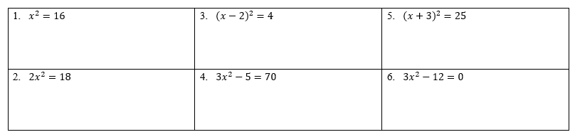
Seatwork 1
Solve the quadratic equations. Box your final answer.

Slide 19

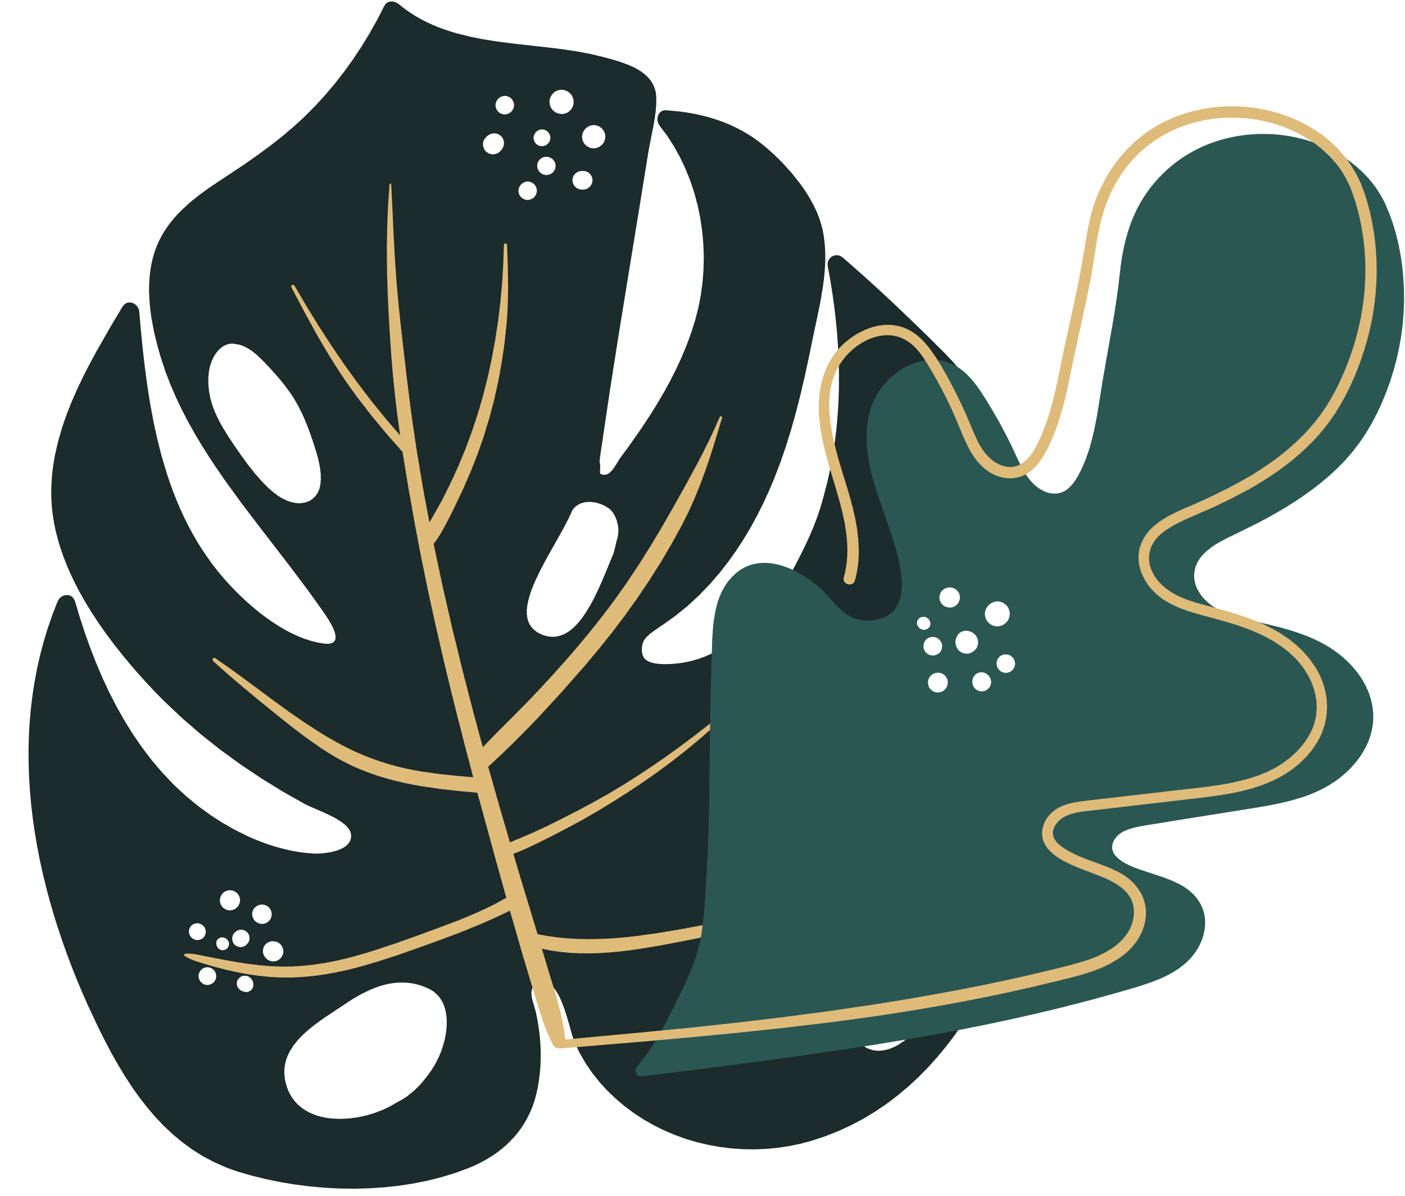
Compassion
Just as solving a problem requires patience and careful thinking, helping others also takes time and effort. How can you show compassion when someone is struggling to understand a lesson or solve a problem?

